Slide 1
Nail Salon Booking Website
Individual Project COSC 412
Shannon Kelly

Slide 2
Overview
Nail salon appointment booking through the phone or in person can be chaotic and challenging for the employees and customers, especially during the current pandemic
Goal: Limit the traffic of calls to the salon and create ease for existing clients to book appointments independently

Slide 3
Features
Log-in provided by salon to existing clients which allows personal account and password for booking
Booking with password required to ensure serious inquiries
Email confirmations
Gallery to show previous work and give ideas for nails
Link to connect with us through Instagram
Reviews for clients to give their opinion of the salon to inspire new clients with affirmation of a clean and fun environment
Full list of products used with description
Payment option to allow quick and easy transactions during COVID-19

Slide 4
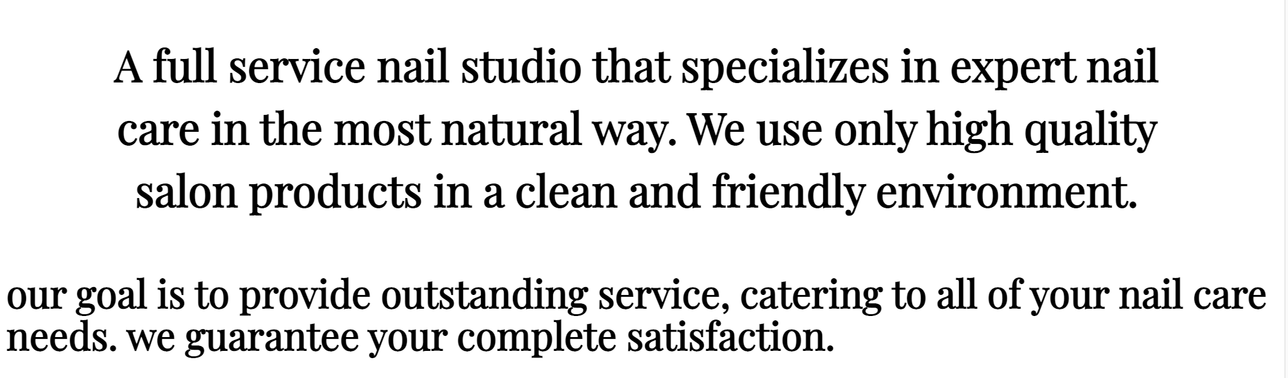
https://mynailsalonbook.me/
When initially navigating to the site, users will see a description of the salon and be able to access all of the features offered from the dropdown menu

Slide 5
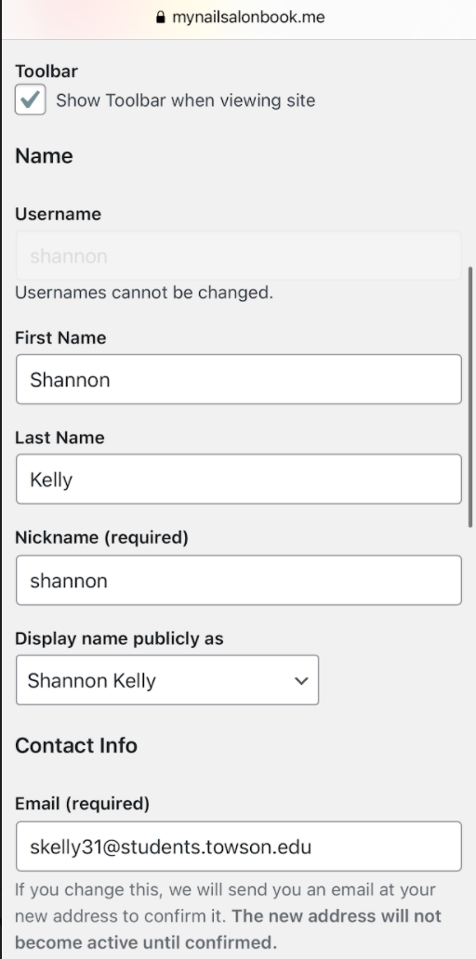
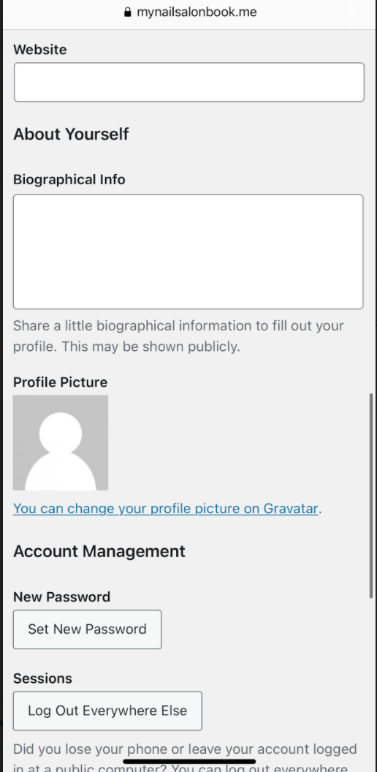
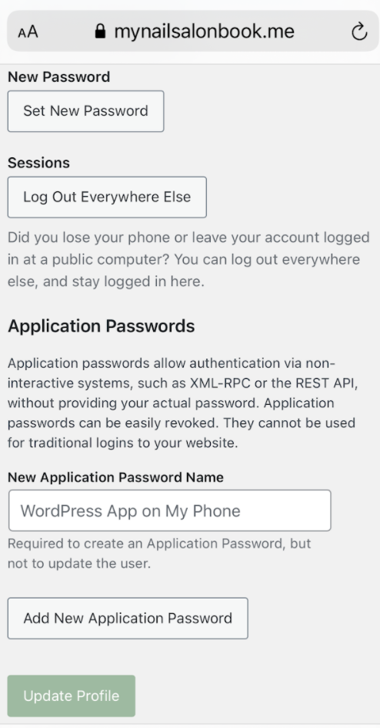
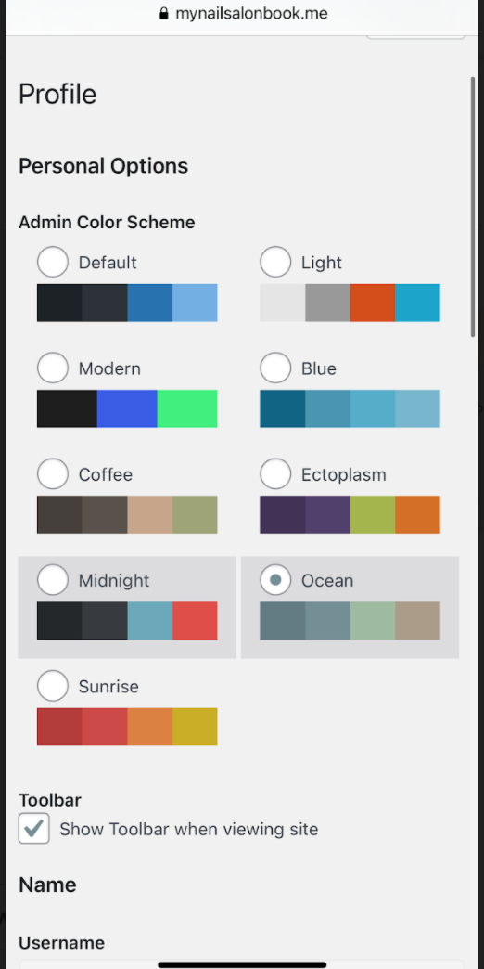
LOG-IN Customizing customer account

Slide 6
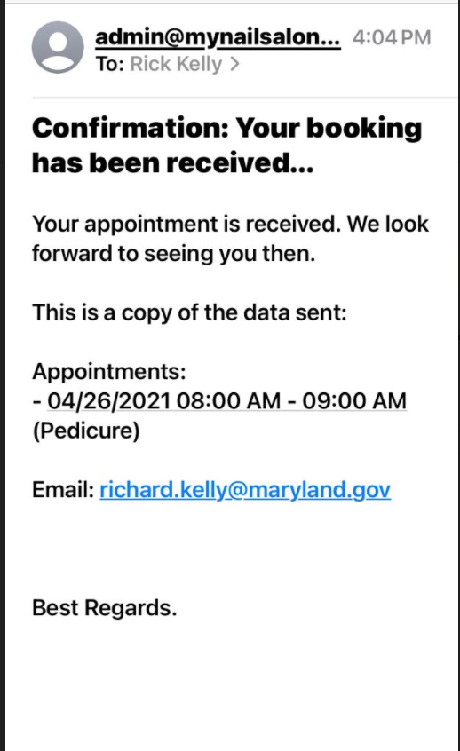
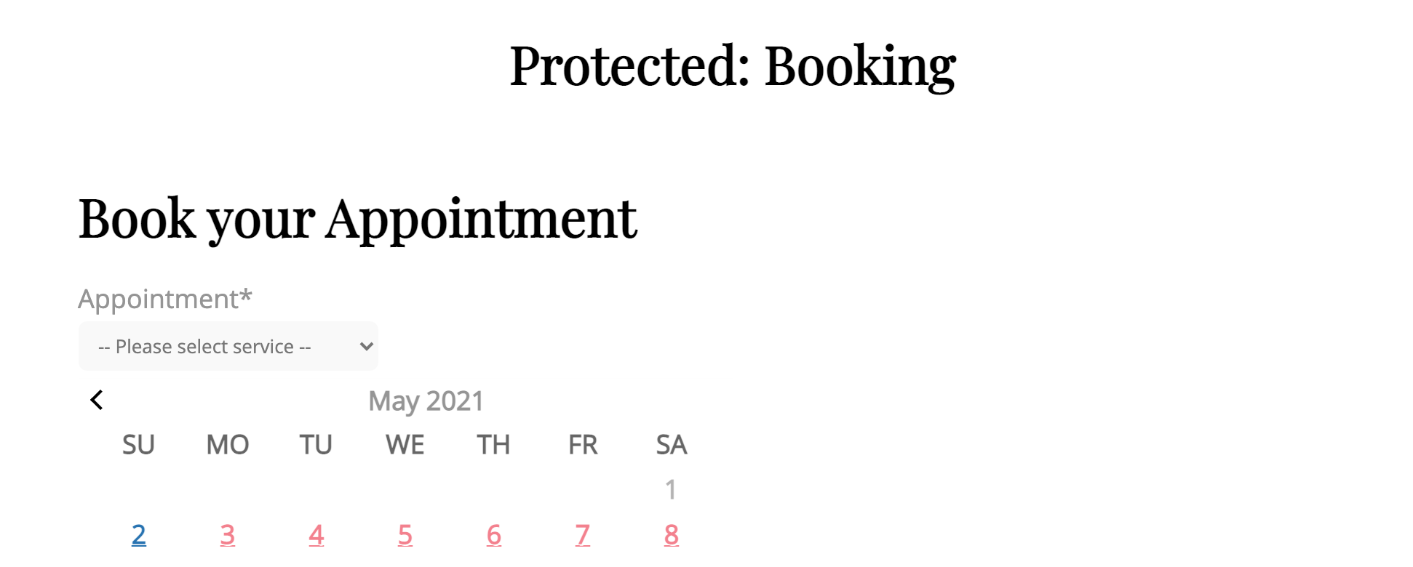
Booking & Confirmation
Users can navigate to the “BOOKING” tab and select their desired service, date, and time. They will receive a confirmation email to ensure their spot!

Slide 7
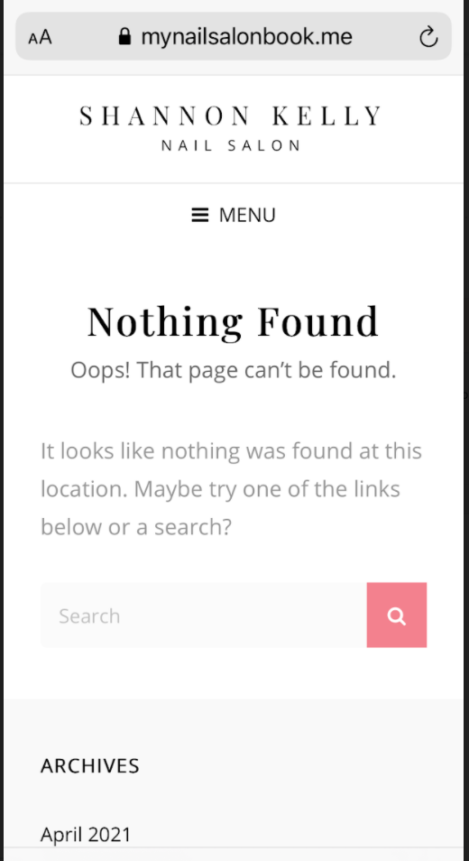
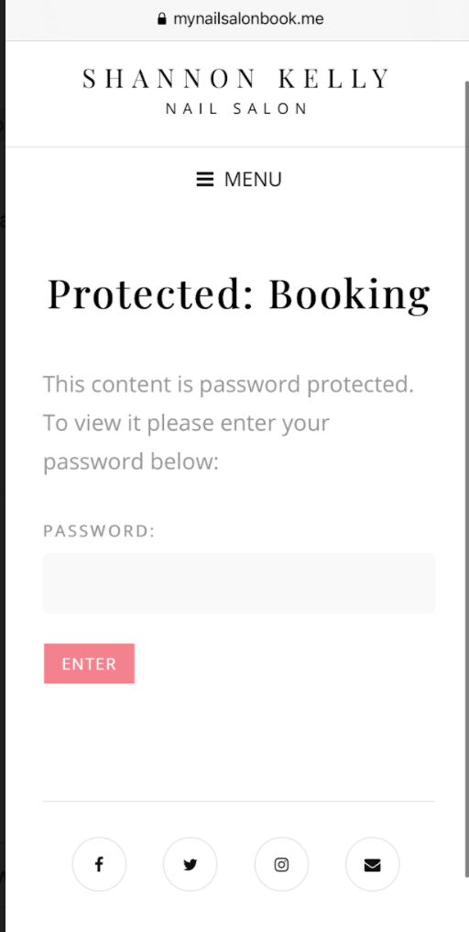
Inability to book appointment without account

Slide 8
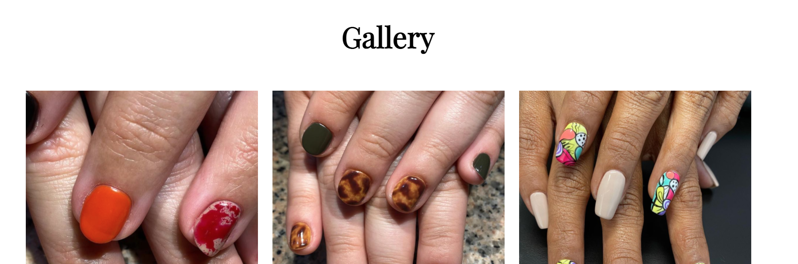
Gallery & link to connect through Instagram
Users can navigate to the “GALLERY” tab to observe previous work done by the nail tech and gain ideas for future appointments
https://www.instagram.com/miasorellanailstudio/

Slide 9

Product list
Users can navigate to the “PRODUCTS” tab to get a full description of the nail polishes used in order to decide what may be best for them

Slide 10
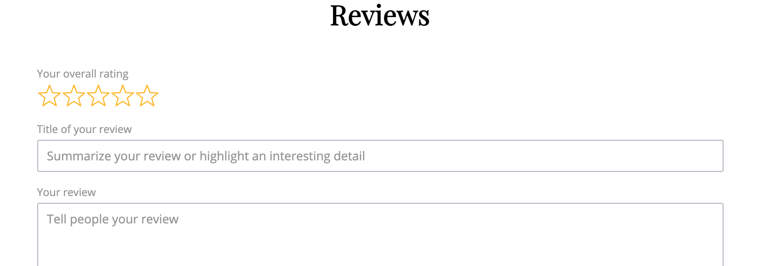
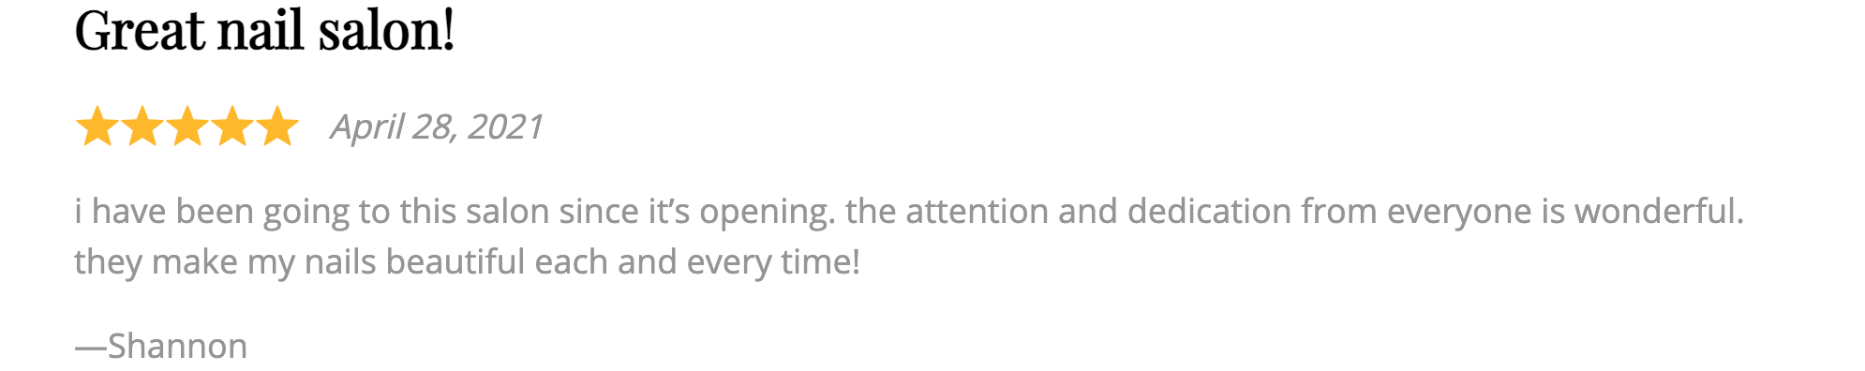
Reviews
Users can navigate to the “REVIEWS” tab to access previous clients opinions on the salon and services or write their own!

Slide 11
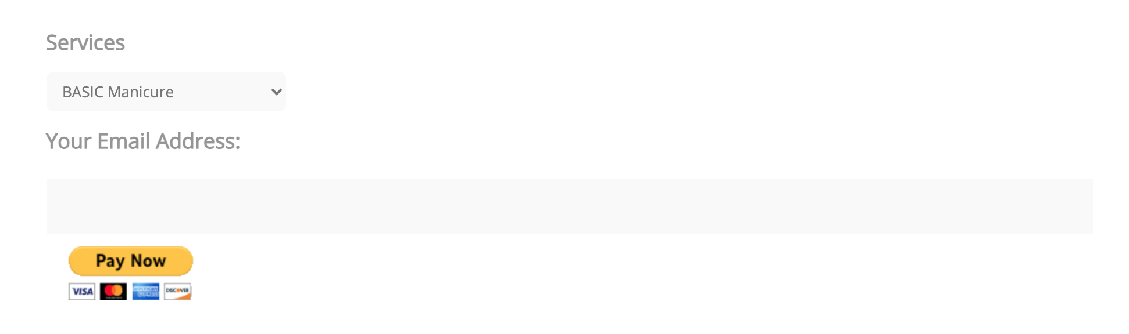
Payment
Users may navigate to the “PAYMENT” tab in order to pay in advance to limit the amount of time in the salon during the pandemic.

Slide 12
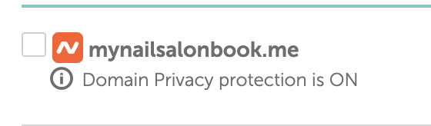

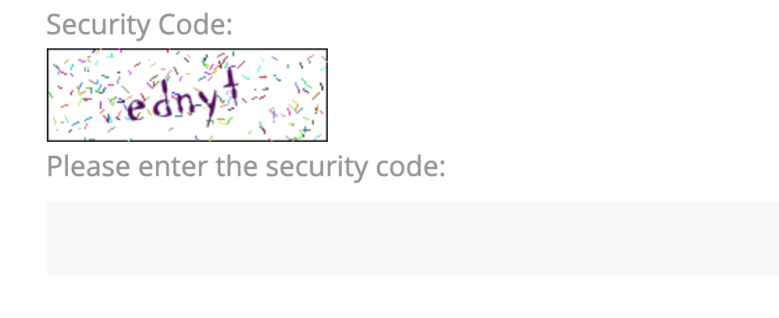
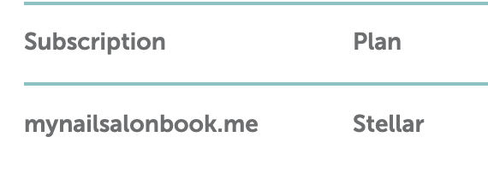
Setup Information
Domain mynailsalonbook.me through namecheap
Domain privacy protection SSL
Hosted through Stellar
reCAPTCHA for booking

Slide 13
Tools USED
Github
Wordpress
Namecheap
Paypal

